Slide 1


GENERAL Training VS ACADEMIC IELTS
Choose the Right Test
Notes:
NOTE:
“Choosing the wrong IELTS test doesn’t just lower your score— it can cost you months of study, extra exam fees, and even visa rejection.”
“Hello, my name is April Ampong, and I’m an instructor at IELTS NINER REVIEW CENTER— an international-standard IELTS training system that helps learners progress from beginner level to Band 7.0–9.0 in the most time-efficient way.”
“In this video, I’ll help you clearly understand the difference between IELTS Academic and IELTS General Training, so you can choose the right test from the start.”

Slide 2
There are two main versions of IELTS
I
IELTS Academic
IELTS General Training
ARE THEY THE SAME????
NO
But they are related
Similarities
Listening – same format, same questions, same difficulty
Speaking – same test, same examiner, same marking criteria
Band score system – both use 0–9 bands
Test length – about 2 hours 45 minutes
Examiners & assessment criteria – exactly the same
Accepted worldwide – universities, employers, and immigration bodies
Differences:
Reading and Writing
Notes:
“In the previous video, we learned what IELTS really is and how it is marked. Now comes the most important decision before you start studying.”
“IELTS Academic… IELTS General Training… Are they the same?
This is one of the most common questions we get — and the short answer is no, they are not the same, but they are related.
Both tests measure your English ability in Listening, Reading, Writing, and Speaking, and both are internationally recognized.
They also differ in Reading and Writing. Academic focuses on academic texts and data, while General Training focuses on everyday and workplace English. In Writing Task 1, Academic candidates describe graphs or charts, while General Training candidates write a letter.
Understanding this difference is very important, because choosing the wrong test can delay your goals.
In the next slides, we’ll help you decide which IELTS test is right for you.”

Slide 3
IELTS Academic – Who Is It For?
IELTS Academic is designed for Academic and Professional study
If you plan to:
Study at a university or college
Apply for a master’s or PhD program
Register with professional bodies such as medicine, nursing, or engineering
Notes:
IELTS Academic is intended for people who plan to study at universities, apply for professional registration, or enter an academic environment. The reading and writing tasks focus on academic language, research, and formal analysis.

Slide 4
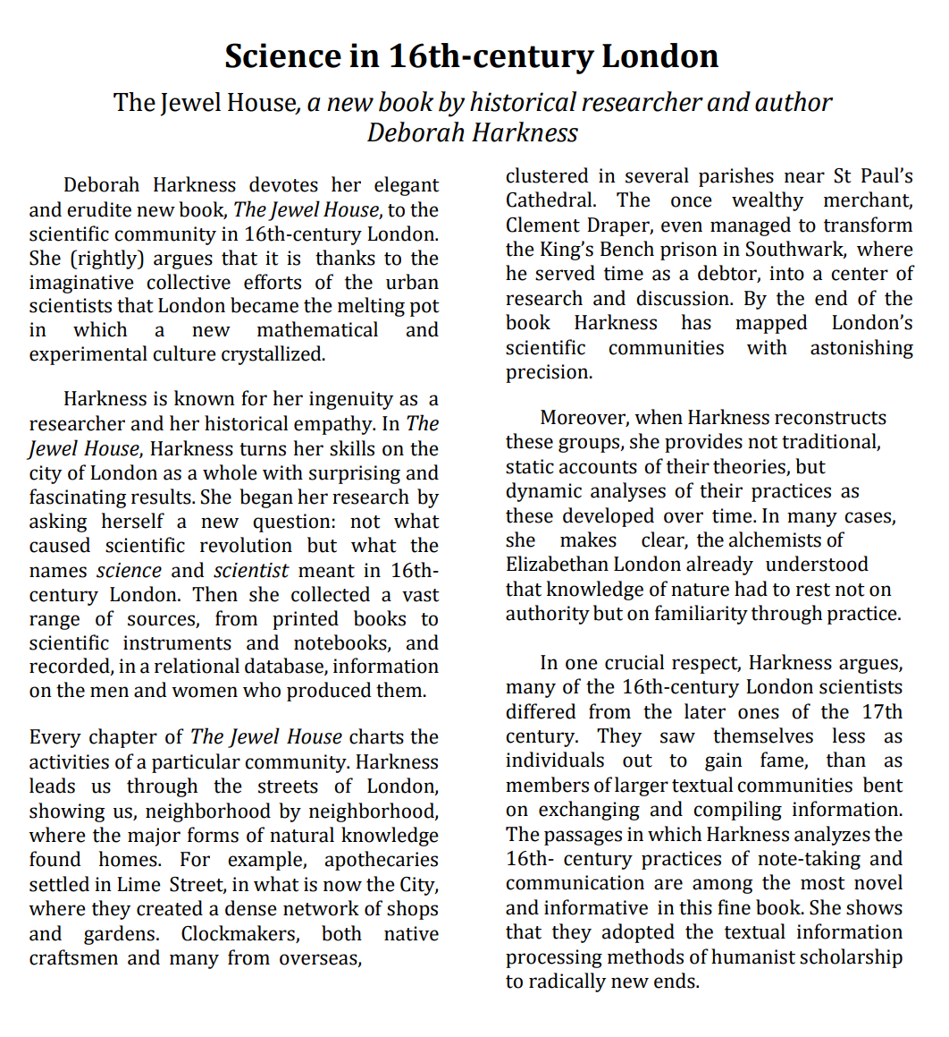
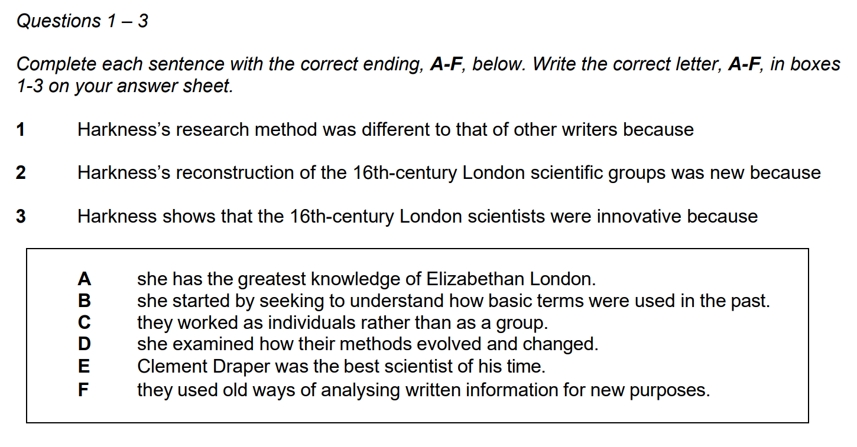
ACADEMIC
READING
Reading texts are longer and more academic
Notes:
Academic Reading is the Reading section of the IELTS Academic test. It checks how well you can understand formal, academic-style texts like the ones used at university level.
It consists of 3 long reading passages taken from:
Books
Academic journals
Research articles
Newspapers or magazines (academic tone)
These texts are written for non-specialist readers, so you don’t need expert knowledge of the topic.
You may see:
Descriptions of scientific research
Articles about history, education, environment, or technology
Texts with graphs, charts, or diagrams
Arguments and opinions supported by evidence
Common question types
Multiple choice
True / False / Not Given
Matching headings
Matching information
Sentence completion
Summary completion
Diagram or flow-chart completion

Slide 5


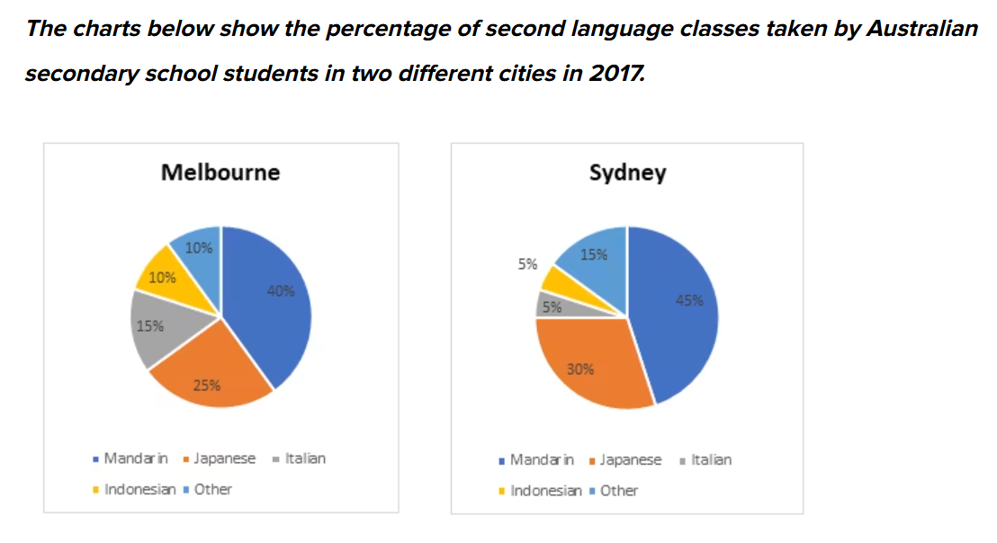
Some people think that parents should teach their children how to be good members of society. Others, however, believe that school is the best place to learn this. Discuss both views and give your own opinion.
ACADEMIC WRITING
Writing Task 1 requires you to describe charts, graphs, or diagrams
Writing Task 2 is an academic essay”
In many countries around the world, rural people are moving to cities, so the population in the countryside is decreasing.
Do you think this is a positive or a negative development?
Notes:
IELTS Writing Task 1 is the first part of the IELTS Writing test. The task is different for Academic and General Training, but both test your ability to describe information clearly and accurately.
Time recommended: 20 minutes
Word count: At least 150 words
Weight: About 33% of the Writing score
In Academic Task 1, you must describe visual information, such as:
Line graphs
Bar charts
Pie charts
Tables
Maps
Processes (e.g. how something works)
What you need to do:
Summarise the main features
Compare data where relevant
Report trends (increase, decrease, stability)
Do NOT give opinions
IELTS Writing Task 2 is the second and most important part of the Writing test. In this task, you must write an essay responding to a point of view, argument, or problem.
You are given a topic and a question, and you must:
Present ideas clearly
Support your ideas with reasons and examples
Organise your essay logically
Use accurate grammar and vocabulary
📌 Both IELTS Academic and General Training have Writing Task 2 essays

Slide 6
IELTS General Training – Who Is It For?
“You need IELTS General Training if you plan to:
Apply for immigration
Work overseas
Study below university level
Notes:
IELTS General Training (GT) is designed for people who need English for everyday life, work, and migration, rather than academic study.
People applying for immigration or permanent residence (e.g. Canada, Australia, UK, New Zealand)
Workers and professionals Who need English for the workplace or job applications
People applying for work visas Or employment-related training programs
Students planning non-degree courses Such as vocational training or short-term certificates

Slide 7
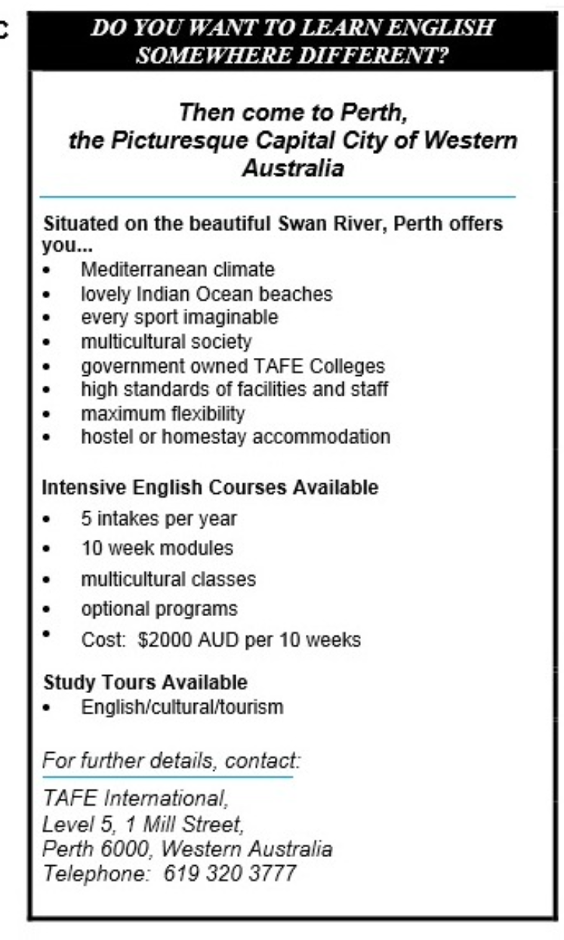
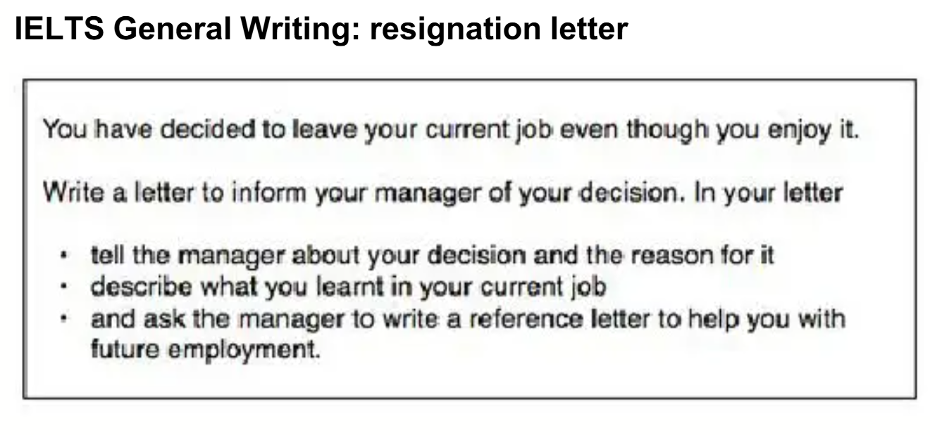
Notes:
In General Training Task 1, you must write a letter, which can be:
Formal
Semi-formal
Informal
Common situations:
Asking for information
Making a complaint
Explaining a problem
Requesting or giving advice
“Now, let’s talk about IELTS General Training Reading.
The General Training Reading test is designed to assess your ability to understand everyday English used in daily life and the workplace.
This section lasts 60 minutes and contains 40 questions. All questions carry one mark each.
The test is divided into three sections, and the difficulty increases as you move forward.
Section 1 focuses on social survival. You will read short texts such as advertisements, notices, timetables, and emails. These are situations you may encounter in daily life, such as finding accommodation or understanding public information.
Section 2 focuses on workplace survival. The texts are related to jobs and work environments, such as company policies, job descriptions, or staff announcements.
Section 3 is the most challenging part. It includes one longer article on a general topic, often taken from newspapers or magazines. This section tests your ability to understand detailed information and main ideas.
Overall, IELTS General Training Reading measures how well you can use English in real-life, practical situations, especially for work and migration purposes.”

Slide 8
How to Choose the Right Test
Ask yourself just one question: What does the organization or country require?”
Never choose based on which test you think is ‘easier’.
Always check:
University requirements
Immigration websites
Employer or institution guidelines
If you choose the wrong test, your score may be completely invalid for your purpose.
Notes:
“Before choosing an IELTS test, ask yourself just one important question: What does the organization or country require?
You should never choose a test just because you think it is easier. Choosing the wrong test can cause serious problems.
Always take time to check the official requirements. This includes university admission requirements, immigration websites, and employer or institution guidelines.
Remember, if you choose the wrong IELTS test, your score may be completely invalid for your purpose, even if your band score is high.
So, always check first—then choose the correct test.”

Slide 9
Our Advice at IELTS NINER REVIEW CENTER
At IELTS NINER REVIEW CENTER, we always determine:
Your goal
Your required IELTS type
Your target band score before designing your study plan.”
This step alone saves our students months of unnecessary study.
Notes:
“At IELTS Niner Review Center, we don’t guess—we plan smart.
We identify your goal, the correct IELTS test, and your target band score first. Then we design your study plan.
This simple step saves our students months of wasted time and gets results faster.
“Now that you know which IELTS test to take, the next big question is this:”
“What do IELTS band scores really mean—and what level do you actually need?”
“In the next video, I’ll break down IELTS band scores so you know exactly where you are and where you need to go.”
“See you in the next video.”

